Slide 1

Getting to Know Your Classmate
Enter your partner’s name here

Slide 2
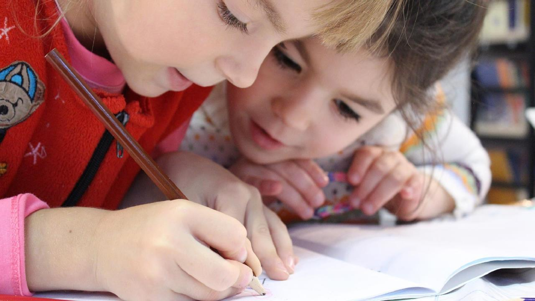


Meet (Enter name here)
He/she is _______ years old.
His/her birthday is _______.
He/she has _____ brother(s) and ______ sister(s).

Slide 3
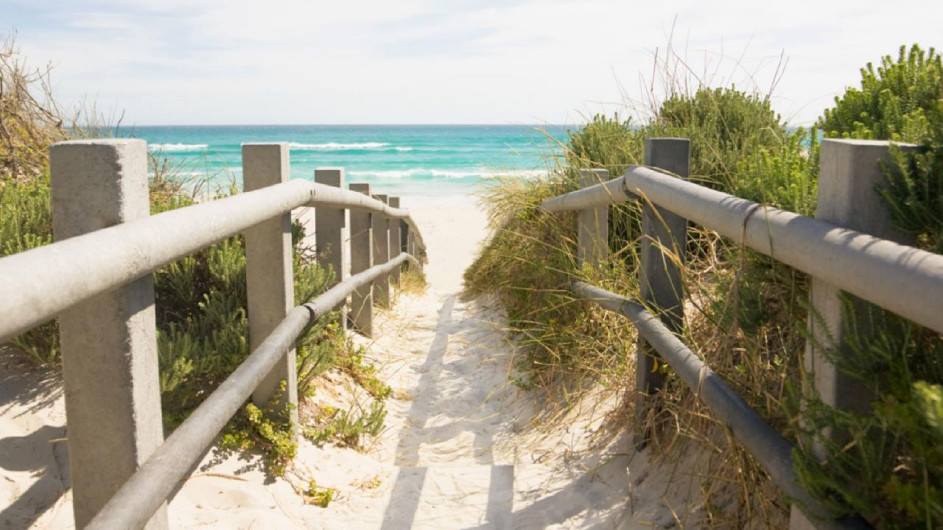

Vacation
His/her favorite vacation spot is _________________.
If (Enter student name) could travel anywhere in the world, he/she would travel to ____________________ because ___________________.

Slide 4
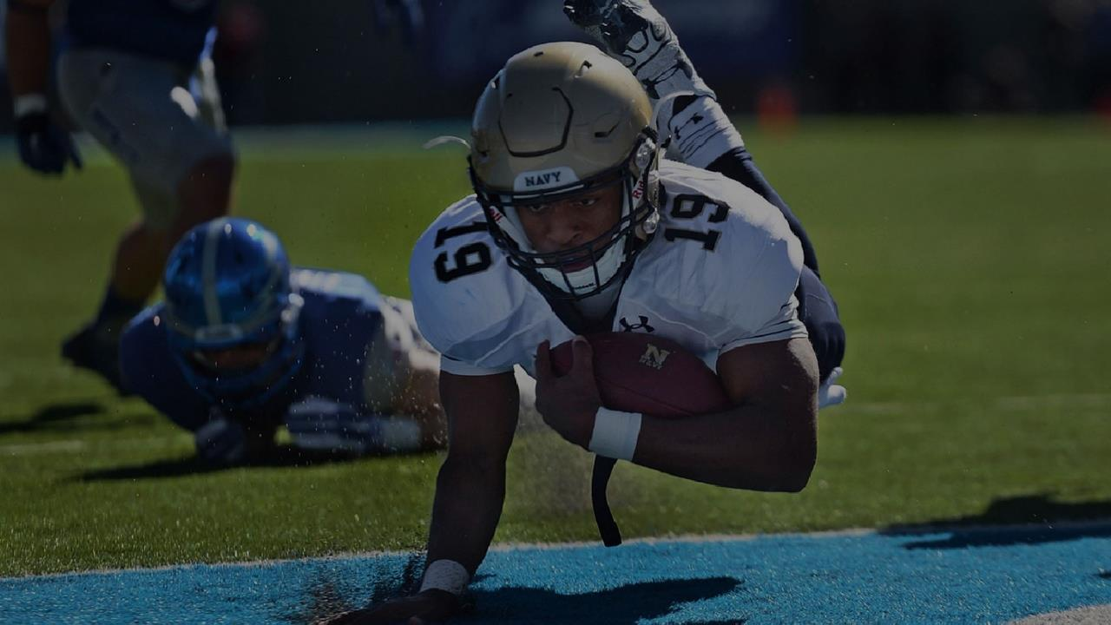



Favorite sport and team
Enter his/her favorite sport here.
Enter his/her team here.

Slide 5
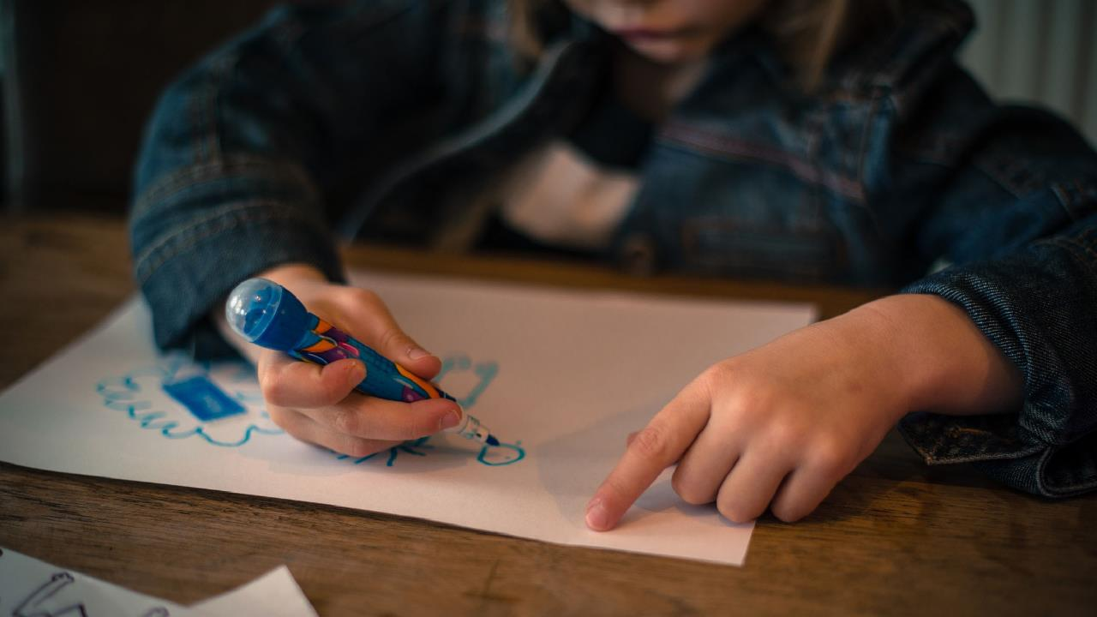



A few of (Enter student name)’s hobbies and interests
Enter his/her hobby here.
Enter his/her hobby here.
Enter his/her hobby here.
Enter his/her hobby here.

Slide 6


Best part about school
(Enter favorite school subject/activity #1) is (Enter student’s name)’s favorite part of school because _________________.
They also enjoy:
Enter favorite thing about school #2.
Enter favorite thing about school #3.

Slide 7
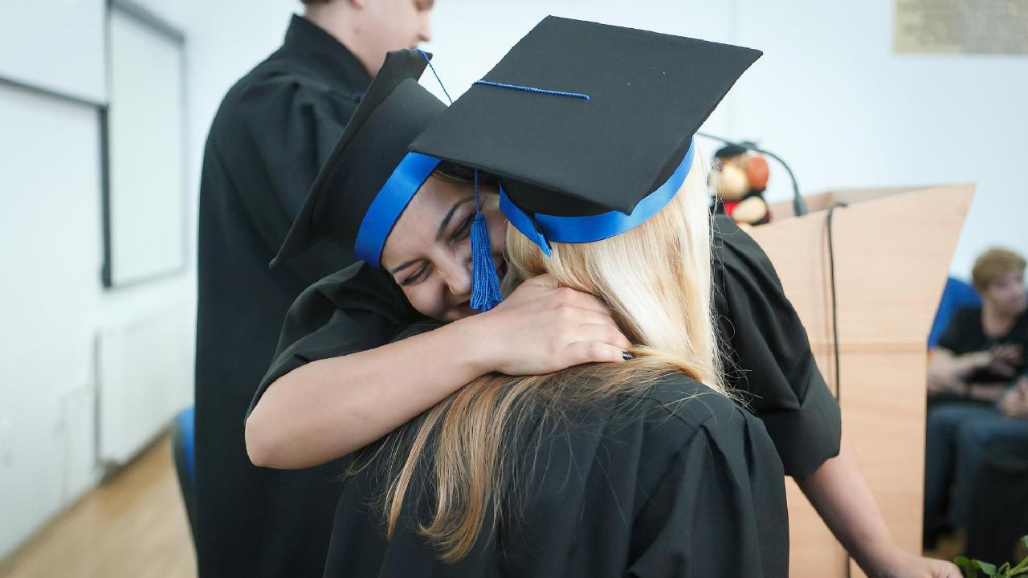


Future career
(Enter student name) would like to be a ____________ when they grow up because ____________________________.

Slide 8



Fun facts
Name his/her special talent.
Name something that makes him/her happy
Name his/her favorite book.
Name his/her favorite movie.

Slide 9
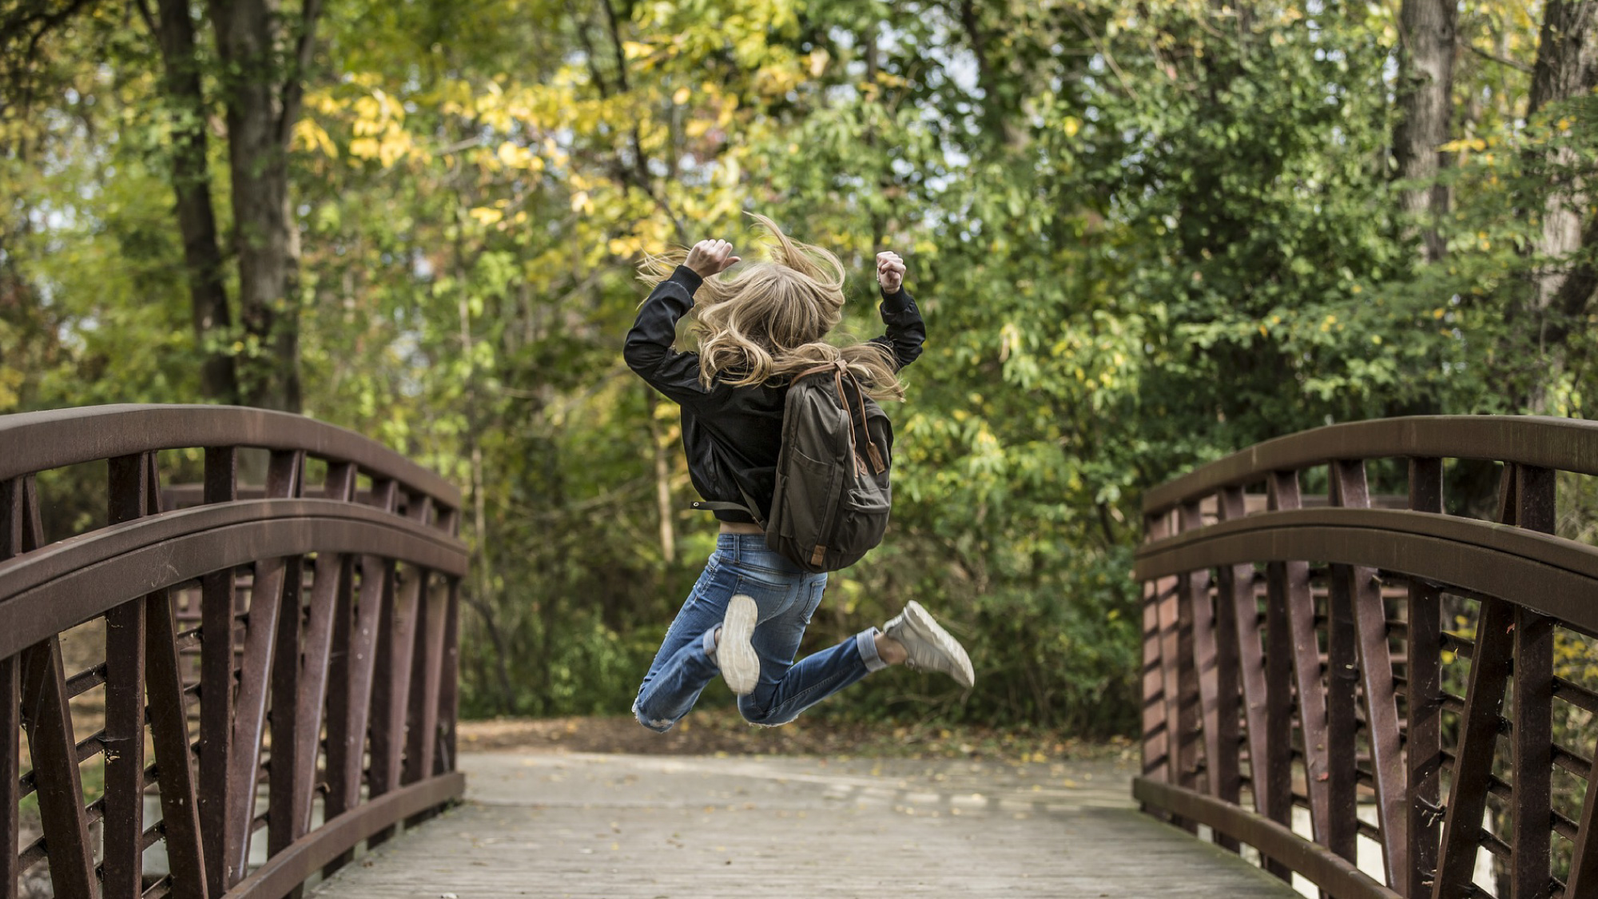


Favorite thing I learned about (Enter student name)
List something kind about your partner.
List something interesting about your partner.

Slide 10
Customize this Template
Template Editing Instructions and Feedback

